Slide 1

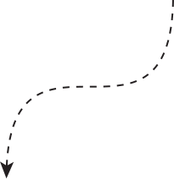



By G.Naga Raga Chandrika
K.Subhanbee
Bindya KR
N. Dheeraj
N.Afwaan Khan
Swiping
MACHINE

Slide 2

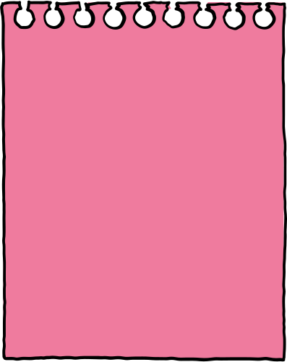

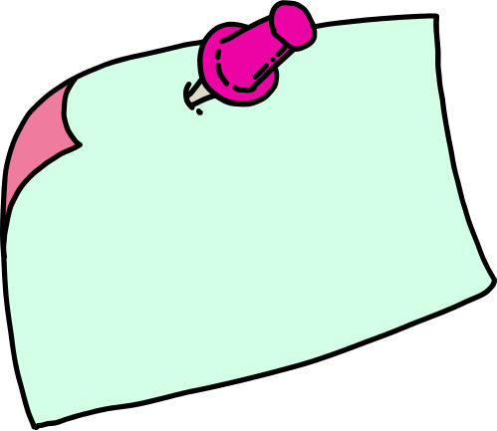
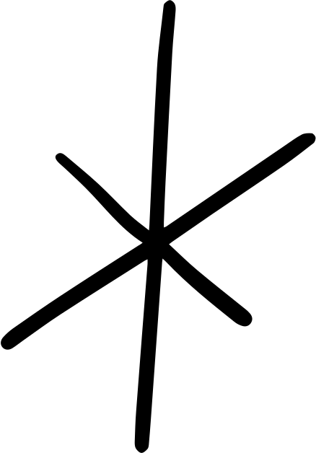
Introduction
HTML
CSS
Java Script
Java
Execution
Conclusion
Agenda

Slide 3

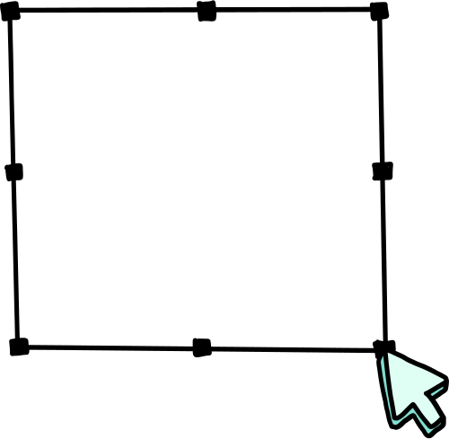
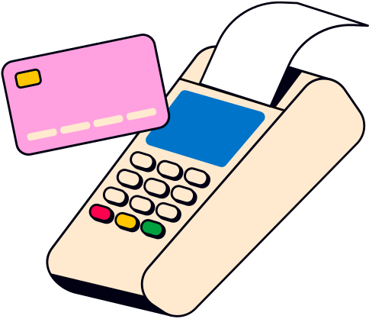
Introduction
A swiping machine, also known as a card reader or POS (Point of Sale) machine, is an electronic device used to read credit or debit cards for making payments. It allows customers to pay for goods or services by swiping or inserting their card, instead of using cash.
Swiping machines are commonly used in:
Shops and supermarkets
Restaurants and cafes
ATMs
Petrol stations
Swiping Machine

Slide 4
When a card is swiped or inserted:
The machine reads the card information.
It asks the user to enter a PIN or confirm the amount.
It sends the data to the bank for verification.
If approved, the transaction is completed, and a receipt is printed.
Swiping machines make payments faster, safer, and more convenient for both customers and businesses

Slide 5

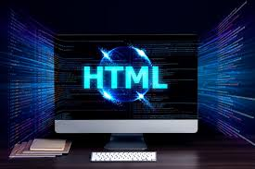

HTML stands for HyperText Markup Language and is the standard language used to create webpages. It uses tags to define elements such as headings, paragraphs, images, and links. HTML provides the basic structure or skeleton of a webpage
HTML

Slide 6
The Swiping Machine is a Java-based application designed to replicate the functionality of a real-time card swiping system commonly used in organizations for attendance tracking and access control. The project captures swipe events, verifies user credentials, and logs entry/exit timestamps with accuracy and security.
This system demonstrates the integration of core Java concepts with database connectivity and file handling, ensuring efficient data storage and retrieval. The application supports administrative features such as user management, report generation, and system monitoring, making it suitable for educational institutions, offices, and secured premises.
The primary objective of this project is to provide a functional prototype that emphasizes secure access management while showcasing practical Java programming skills and software development practices.

Slide 7

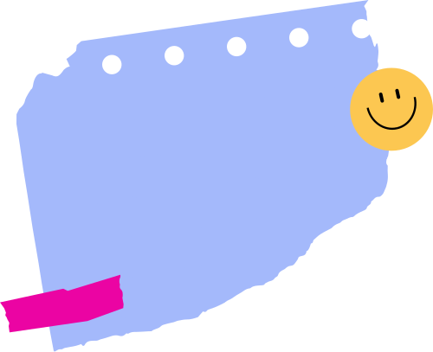
Let's know about css...
CSS
CSS (Cascading Style Sheets) is a stylesheet language used to control the presentation of HTML documents. While HTML is used to create the structure of a webpage, CSS is used to style and design that structure — such as colors, fonts, layouts, spacing, and animations.
CSS helps make websites visually attractive and user-friendly. It separates content (HTML) from design (CSS), making it easier to manage and update styles across multiple web pages.
CSS can be written directly in the HTML file (inline or internal), or in an external .css file that links to the HTML.

Slide 8
Let's know about css...
In the context of a swiping machine or card-based interface, CSS is used to style and design the user interface that appears on the screen when a user interacts with the machine.
While the backend handles the logic of reading the card and processing transactions, CSS is responsible for how everything looks, such as:
Displaying welcome messages in a clear font
Showing buttons like "Login", "History", or "Balance" in an attractive layout
Applying colors for alerts (e.g., red for error, green for success)
Making the interface responsive and user-friendly on different screen sizes or display resolutions
Adding hover effects or animations to buttons when touched or selected
In such systems, CSS ensures that the user experience is smooth, intuitive, and visually clear, which is especially important for quick and error-free interactions.

Slide 9
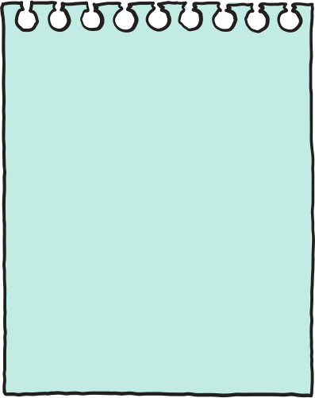

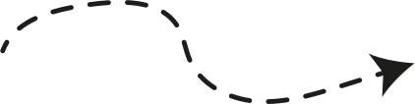
JavaScript is a versatile, dynamically typed programming language used for interactive web applications, supporting both client-side and server-side development.
The script tag is used to include JavaScript code inside an HTML document.

Slide 10
JAVASCRIPT SYNTAX IS SIMILAR TO C AND JAVA.
Making it relatively easy to learn for programmes familiar with those language.
It supports various programming paradigms, including object-Oriented functional, and imperative programming.

Slide 11

Java is a high-level and object-oriented programming language. It was developed by James Gosling at Sun Microsystems in 1995 and is now owned by Oracle Corporation. Java is widely used to build web applications, mobile apps (especially Android), desktop software, games, and enterprise-level systems.
One of the main features of Java is its platform independence, which means a Java program can run on any device that has a Java Virtual Machine (JVM). This is why it is often said, “Write once, run anywhere.”
Java is simple to learn, secure, and supports multithreading and automatic memory management. Because of its powerful features, strong community support, and wide range of applications, Java remains one of the most popular programming languages in the world.

Slide 12
💳 Java in a Swiping Machine – Simple Explanation
Java is a programming language used to build the software that runs inside swiping machines (like ATMs or card readers).
In a swiping machine, Java is used to:
Read the card when it is swiped or inserted
Ask for the PIN number
Check the card and PIN with the bank database
Show options like “Withdraw”, “Check Balance”, etc.
Process the transaction (like sending money request to the bank)
Show success or error messages
Print a receipt if needed
Java is used because it is:
Safe and secure (good for handling money)
Works on any device (cross-platform)
Reliable and fast

Slide 13
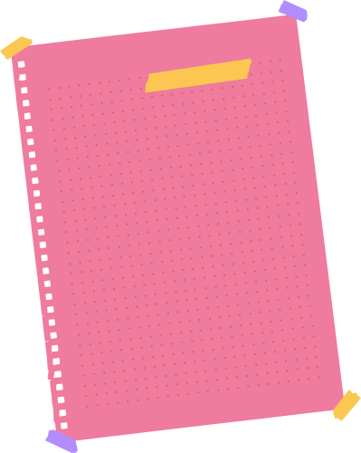



Execution of Code

Slide 14

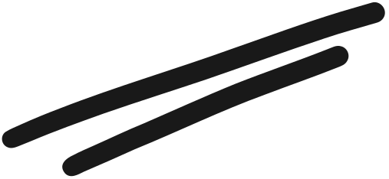
CONCLUSION
Swiping machines play an important role in today’s digital payment system. They make transactions quick, secure, and easy by allowing customers to use their debit or credit cards instead of cash. With the help of software like Java for logic and CSS for interface design, these machines provide a smooth and user-friendly experience. As technology continues to grow, swiping machines will keep evolving to offer even faster, safer, and smarter payment solutions.

Slide 15
THANK
YOU!

